Slide 1
Lidar Apollo & Rtab Map
https://github.com/ApolloAuto/apollo#quick-starts

Slide 2
Apollo versions 1.0-2.5
Apollo 1.0
Automatic GPS waypoint following – controlled/ enclosed env
Apollo 1.5
Lane cruising with LiDAR
Apollo 2.0
Autonomous driving on simple urban road, cruise, avoid collision, stop at traffic light
Apollo 2.5
Autonomous run on geo-fenced highways with camera

Slide 3
Apollo version 3.0-6.0
Apollo 3.0
Closed venue low-speed env, lane ctr, cruise, avoid collisions
Apollo 3.5
Navigate complex drive scenarios with 360-deg visibility and upgraded perception algorithms (navigate narrow streets and stop sign)
Apollo 5.0
Include deep-learning model for changing conditions and complex road scenarios
Apollo 5.5 include new perception deep learning model for increased awareness
Apollo 6.0
New deep learning model for certain apollo model

Slide 4
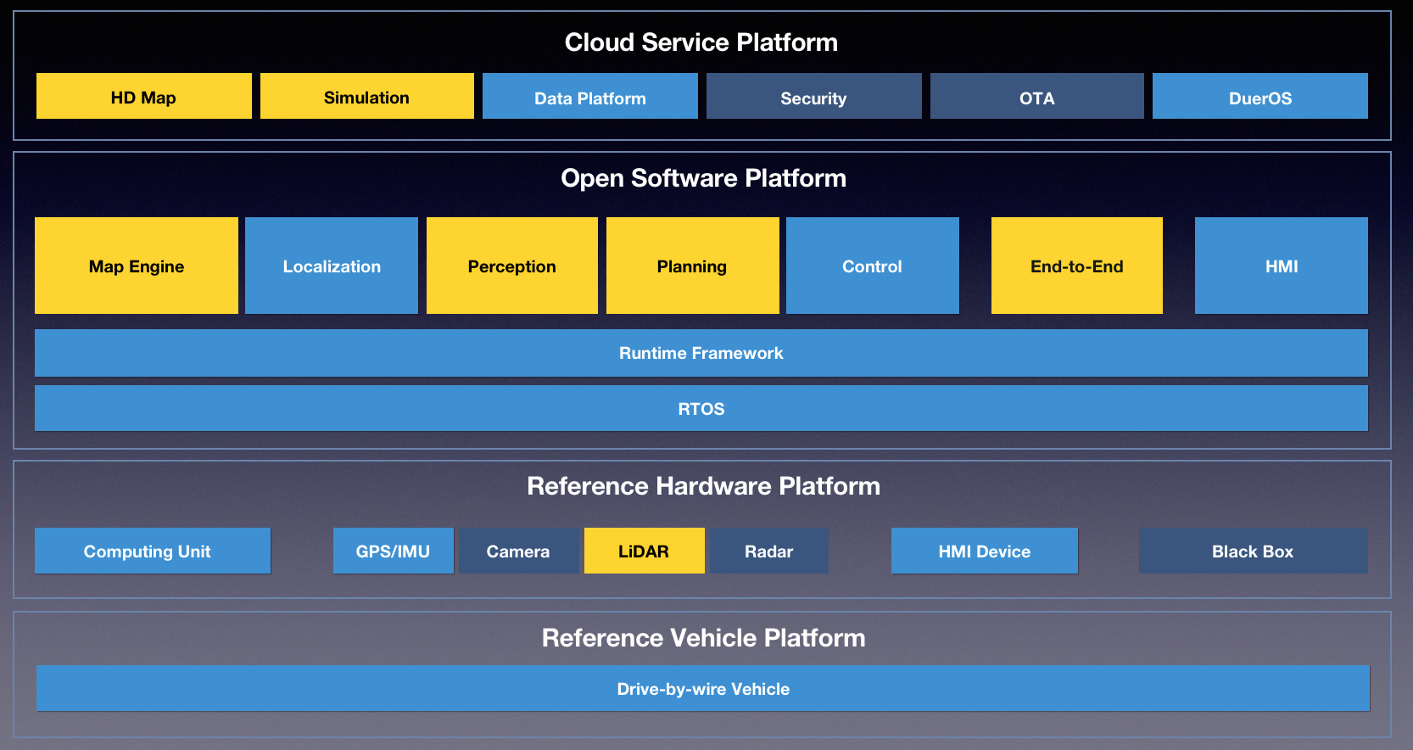
Apollo 1.5 structure

Slide 5
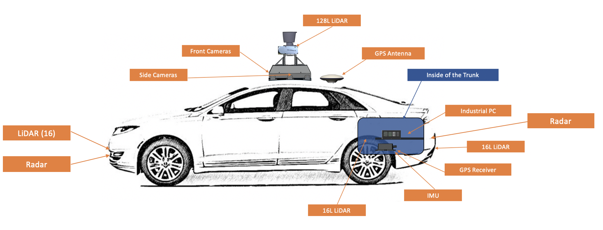

Slide 6
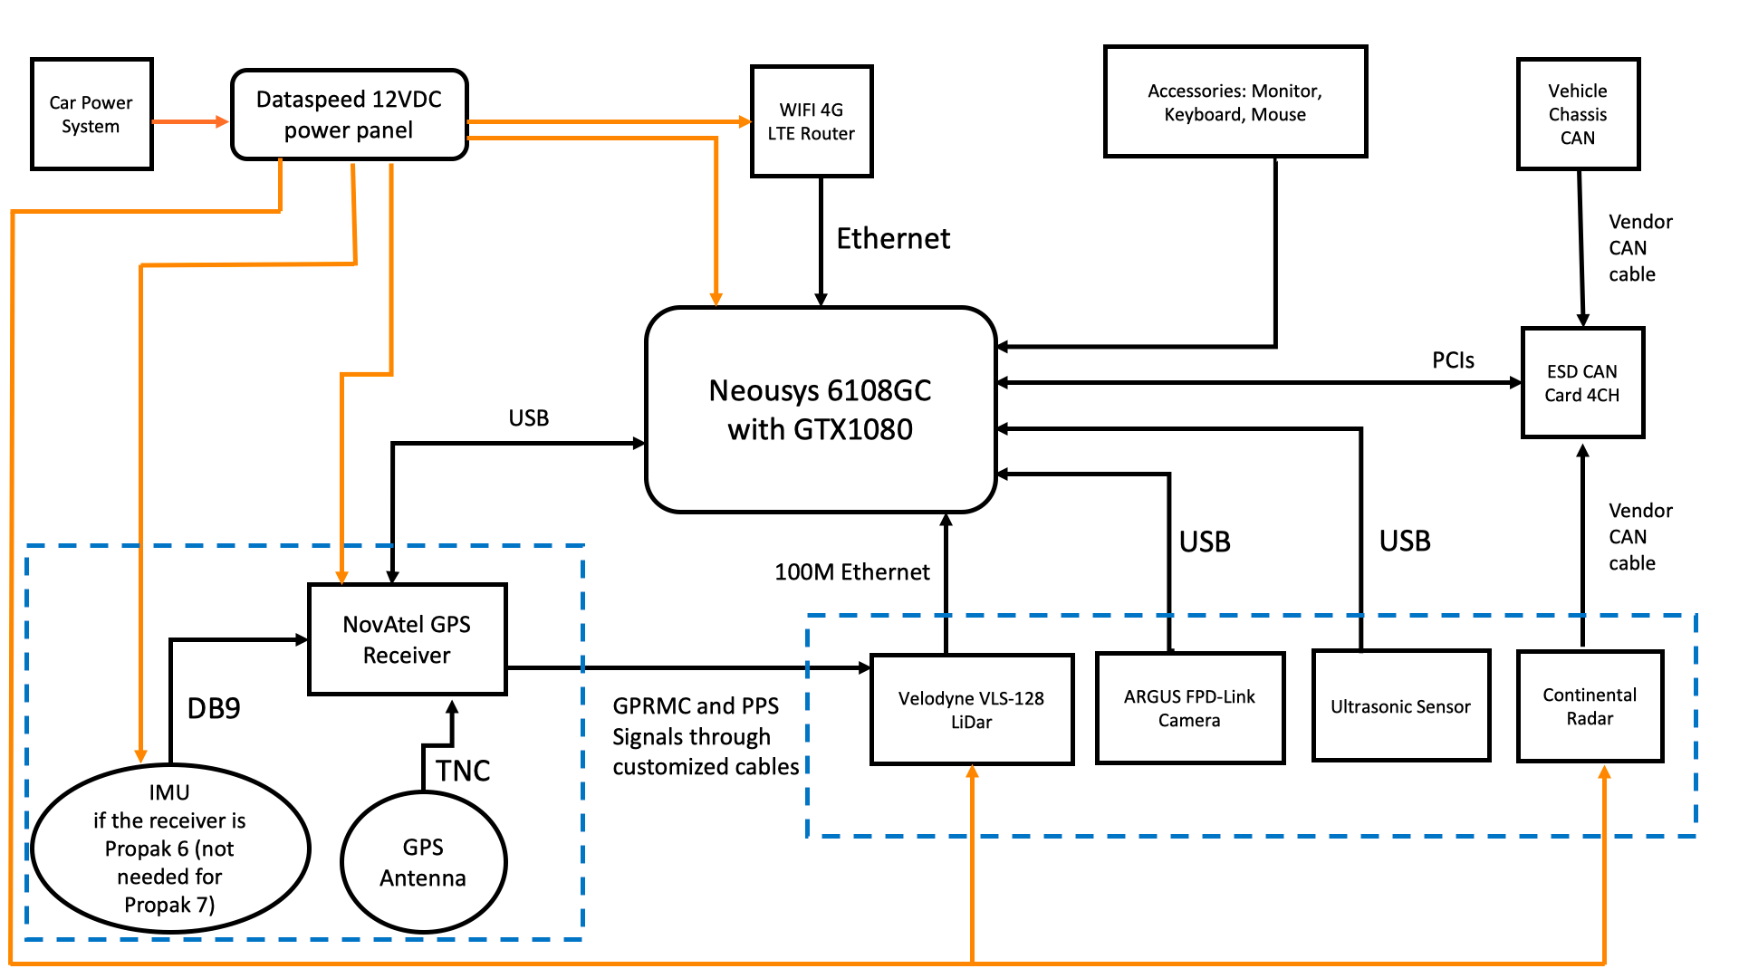
Hardware overview

Slide 7
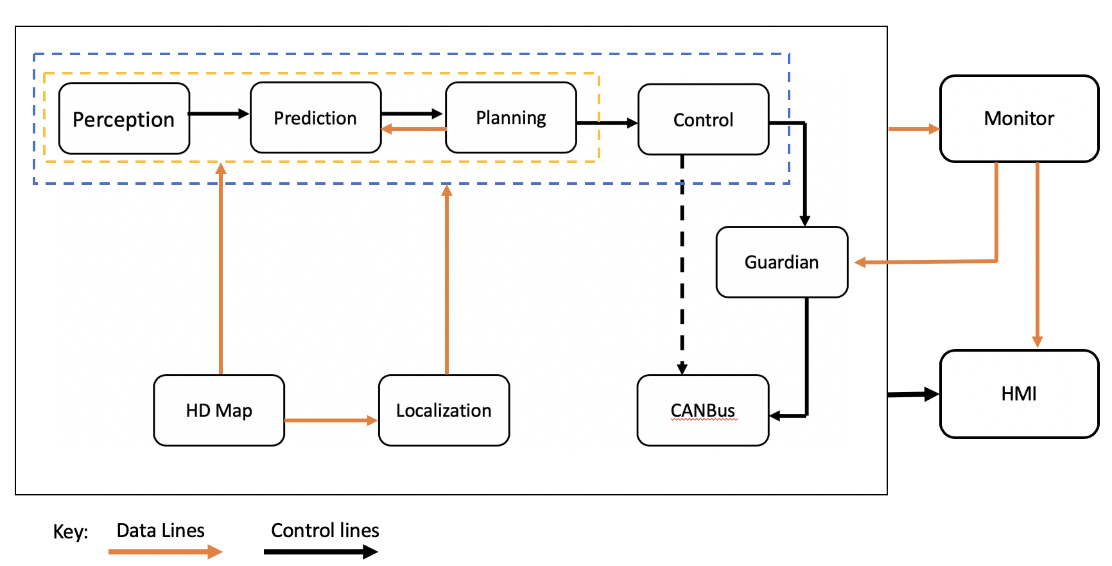
Software Overview

Slide 8
Apollo software architecture
A general rundown on apolo 2.0 powered autonomous vehicle
https://github.com/ApolloAuto/apollo/blob/r2.5.0/docs/specs/Apollo_2.0_Software_Architecture.md

Slide 9
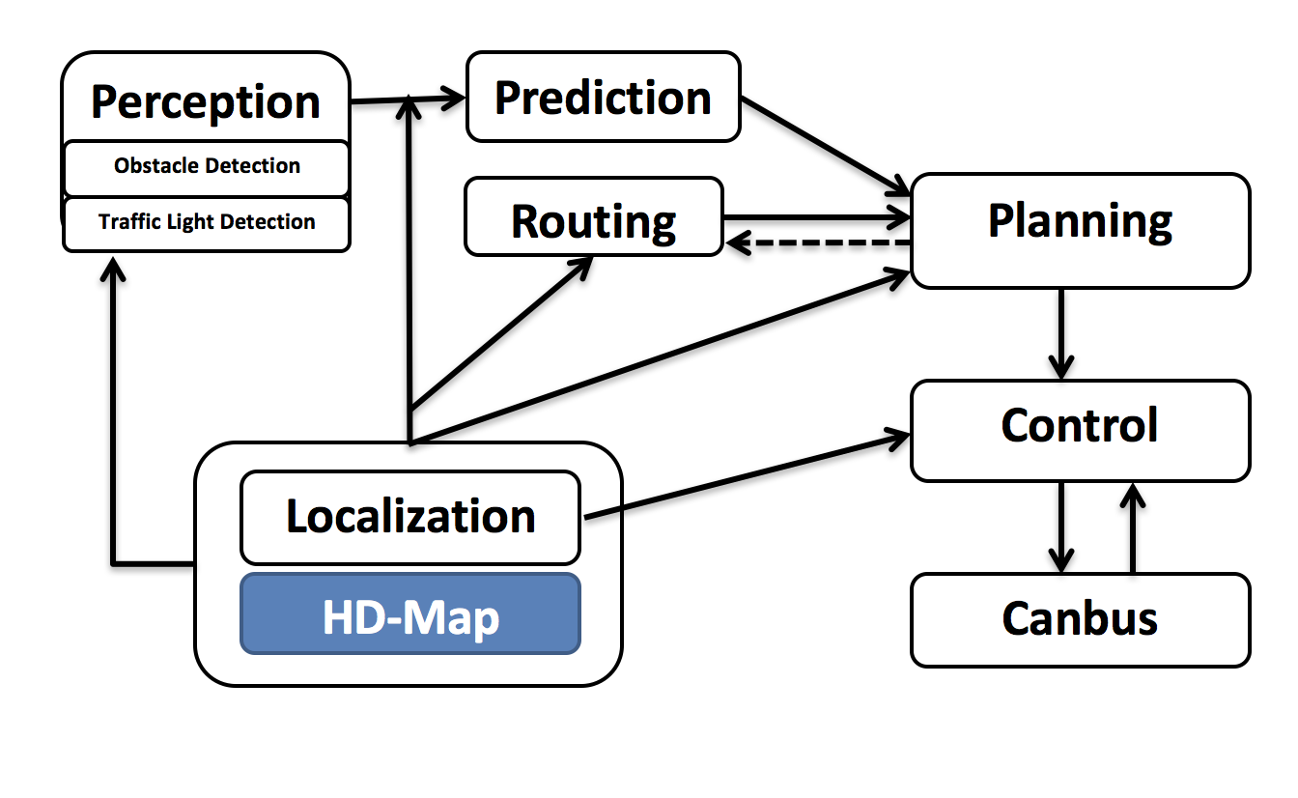
Relation map

Slide 10
Core software modules
Perception – identifies surroundings, two submodules
Obstacle detection
Traffic light detection
Prediction – anticipate future motion trajectories
Routing – tells path to reach destination
Planning – plan spetio-temporal trajectory for vehicle
Control – execute planned trajectory through commands (path to motion)
CanBus – pass control commands to hardware, and chassis info to software
HD-Map – query engine to support ad-hoc structured info
Localization – GPS, LiDAR, IMU (internal measurement unit) to estimate location of vehicle

Slide 11
3D obstacle Perception
https://github.com/ApolloAuto/apollo/blob/r2.5.0/docs/specs/3d_obstacle_perception.md
Three main components
LiDAR obstacle perception – 3D point cloud data from sensor
RADAR obstacle perception
Obstacle results fusion – fuse LiDAR tracking results and Radar detection results
Match sensor results with fusion items by tracking ID
Map association matrix for unmatched sensor results and unmatched fusion items to get optimal match result
Update fusion item using Adaptive Kalman Filter (recursive estimator that estimate params for model)

Slide 12
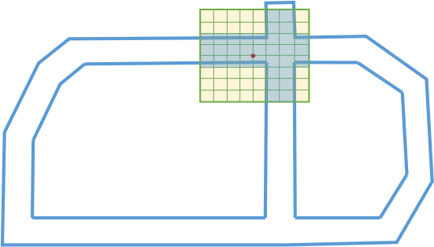
LiDAR Obstacle Perception (part 1)
HDMap ROI filter – specifies drivable area from HD map
Remove background objects and only keep point cloud of ROI for processing
Affiliation of LiDAR point if it is in or out of ROI
Use LookUpTable (LUT) through a 2D grid system to represent each cell
Use scan line algorithm and bitmap encoding for construction of ROI LUT
Blue lines -> HDMap ROI
RedDot – LiDAR sensor location
8*8 cells
Obtain filtered point cloud with only points in ROI
CNN segmentation – object detection and segmentation
Channel feature extraction
CNN-based obstacle prediction
Obstacle clustering
Post-processing

Slide 13
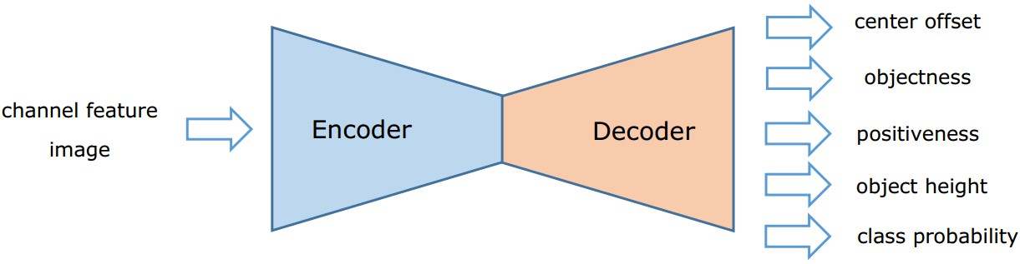
LiDAR Obstacle Perception (part 2)- CNN Feature extraction + obstacle pred
Chanel Feature Extraction
2D grid from local coordinate system with LiDAR as origin
8*8 cells, 8 statistical measurements as input channel to CNN
Max height, intensity of highest point, mean height, mean intensity number of points, angle of cell center to origin, dist between cell center and origin, binary value whether cell is empty of occupied
CNN-based Obstacle prediction (use FCNN) for prediction of obstacle attributes:
Offset displacement with respect to potential object center (Center offset)
Objectness
Positiveness
Object height
Encoding layers -> decoding layers -> prediction
Use non-linear activation layers (Relu)
Input to FCNN : W(col number) * H(row number) * C(Channel features)

Slide 14
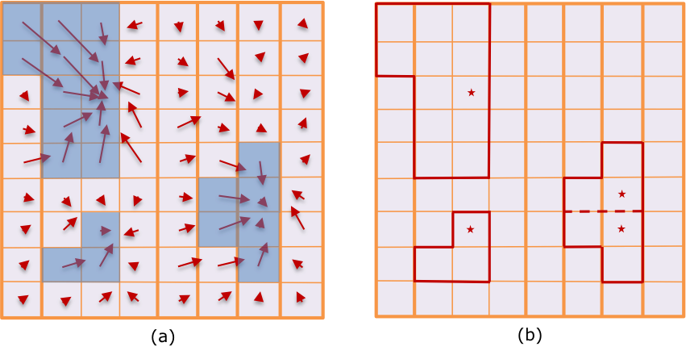
LiDAR Obstacle Perception (part 3) - CNN Obstacle clustering
Obstacle clustering - after prediction of objects in point cloud, generate obstacle objects
Attributes: centre offset, objectness, positiveness, object height, class probability
Construct directed graph, from centre offset prediction to search connected components as candidate object clusters
Each cell is node of graph and directed edge built from centre offset prediction which points to parent node corresponding to another cell
Union find algorithm for connected components
Objectness – prob being valid object for one cell
Non-object cell (prob objectness< 0.5)
Red arrow – centre offset pred of cell
Blue mask – objectness >0.5
Cells in red polygon – candidate obj cluster
Red * root node of subgraph (connected component)

Slide 15
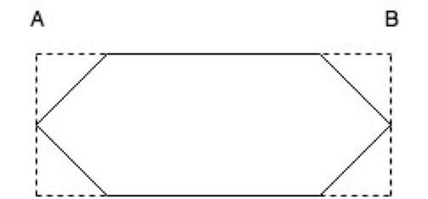
LiDAR Obstacle Perception (part 4) - CNN post processing + Minibox builder
Obtain set of object clusters including several cells
Compute detection confidence score + obj height (average positiveness and object height
Remove overly high points + collect valid points for each candidate cluster
Remove low confidence score candidate clusters
Establish bounding box for detected obstacles (point cloud might be sparse and cover partially surface so need to recover full bounding box given polygon point
Used to estimate heading of obstacle and visualize
Find all areas given edge of polygon point
Eg: given edge AB, establish pair of intersection with max distance (edge to bounding box)
Obtain other edge in bounding box the same way, and iterate all edges of polygon
Determine 6-edge bounding box with min area as final bound box

Slide 16
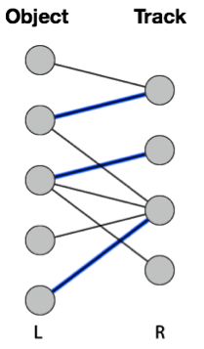
LiDAR Obstacle Perception – HM object tracker (part 5)
HM object tracker
Track objects that are detected after segmentation and miniboxed
Update track list by associate current detections with existing track list, delete old track list if no longer persist, and spawn new one if detect
Detection to track association – apollo construct bipartite graph + Hungarian algorithm to get best detect-to-track matching with min cost (distance) -> obtain association distance matrix
Hungarian algorithm: https://en.wikipedia.org/wiki/Hungarian_algorithm
Bipartite graph matching – use Hungarian algorithm to find best matching while minimizing distance, solve with O(n^3) time complexity
Track Motion Estimation – use Robust Kalman Filter to estimate motion state of track list with const velocity motion model (belief anchor point + belief velocity -> 3D position + 3D velocity )
Robust Kalman Filter : https://www.cvxpy.org/examples/applications/robust_kalman.html

Slide 17
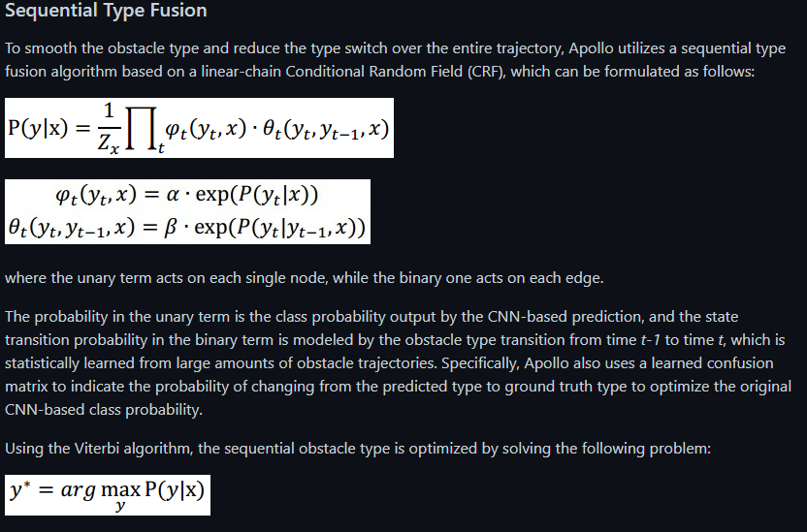
I don’t rly know a lot of this yet but will check

Slide 18
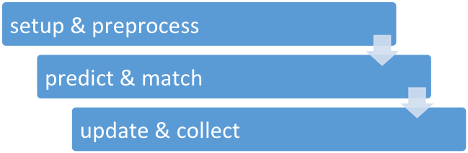
LiDAR Obstacle Perception – HM object tracker + fusion of results (part 6)
Workflow of HM object tracker:
Construct track objects and transform to world coordinates
Predict state of existing track list and match detection to them
Update motion state of updated track list and collect track results
Obstacle results fusion –
fuse LiDAR track results and Radar detection results
Match by ID , compute association matrix for unmatched sensor results and unmatched fusion items
If match, update fusion item using Adaptive Kalman Filter

Slide 19
RTAB map
Real-Time appearance based mapping
Web: https://introlab.github.io/rtabmap/
Mult Sess map: https://github.com/introlab/rtabmap/wiki/Multi-Session-Mapping-with-RTAB-Map-Tango

Slide 20
RTAB map
Real time appearance based mapping
Graph based

Slide 23
TODO: later
Some pointers that I think might be useful

Slide 24
Direction/ guide/ focus
Dart compiling
Native jave and swift
Flutter application building on IOS for testing
https://flutter.dev/docs/get-started/flutter-for/ios-devs
Arkit 5 (check on how to code LiDAR scanner
Apply for Undergraduate Student-initiative experiential Learning Program (USEL)
Non-credit bearing version just to use the labspace and work on project
Maybe instead of buying a new device and test, just build pcb and get cheap parts from Taobao
https://seng.hkust.edu.hk/sites/default/files/IMCE/HKUST_Engineering_USEL_Program_20210823.pdf
Maybe can get a tiny bit of funding also
Might be able to get other smarter people to work with me
more details : https://seng.hkust.edu.hk/academics/undergraduate/blended-experiential-learning/program-details

